Slide 1
All About Artificial Intelligence
Here is where your presentation begins

Slide 2
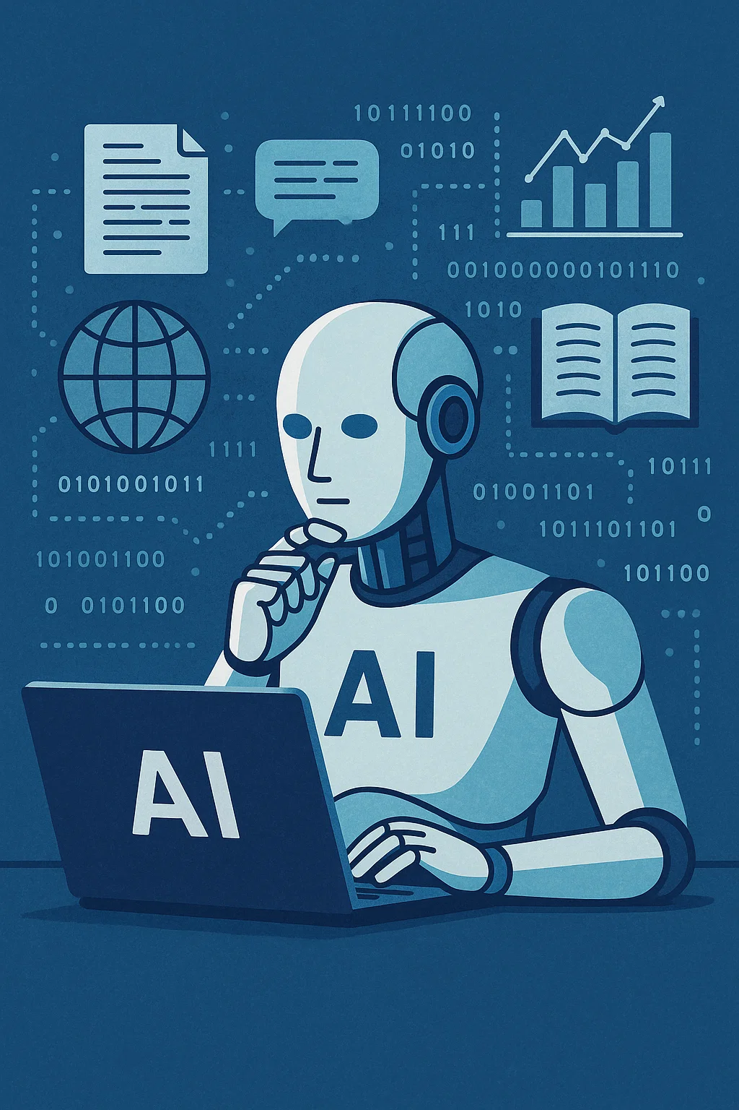
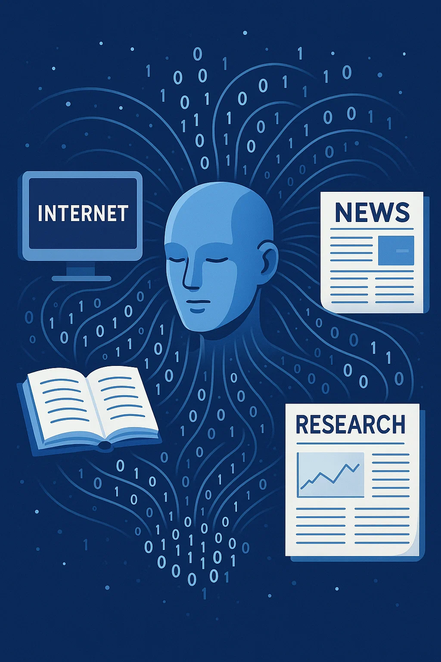
Template #..

Slide 3
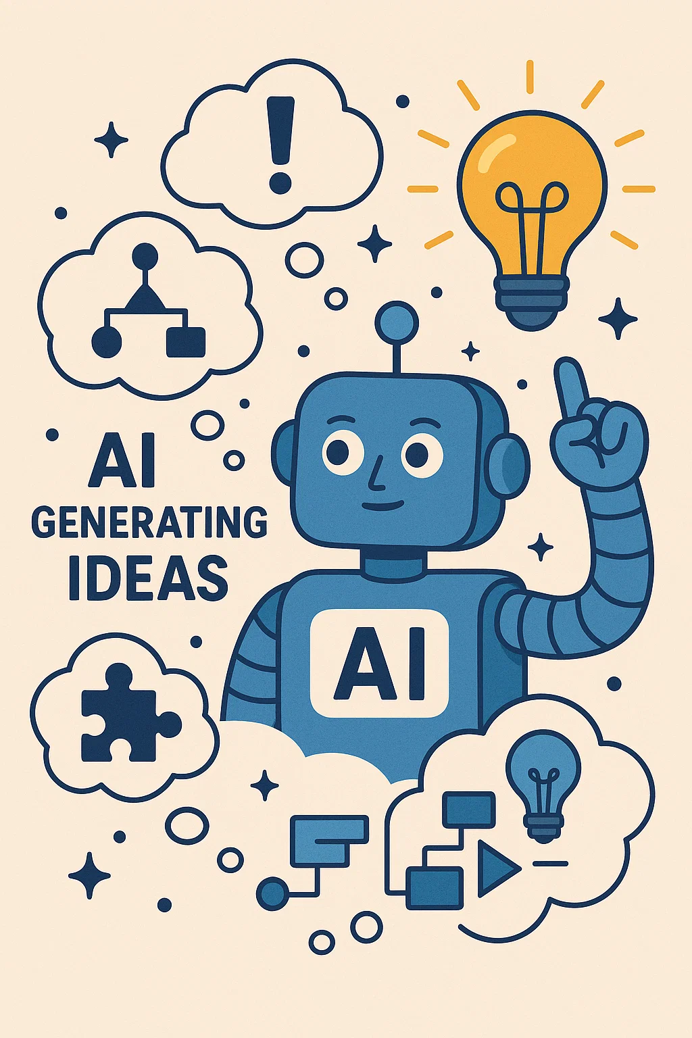
Template #..

Slide 4
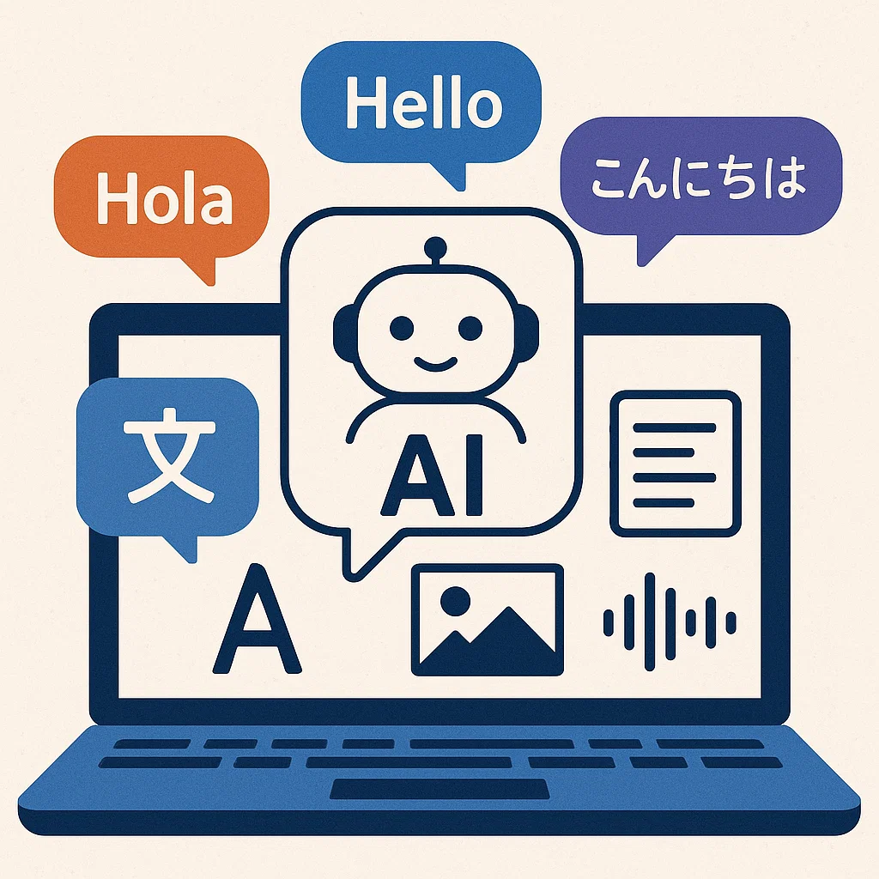
Template #..

Slide 5
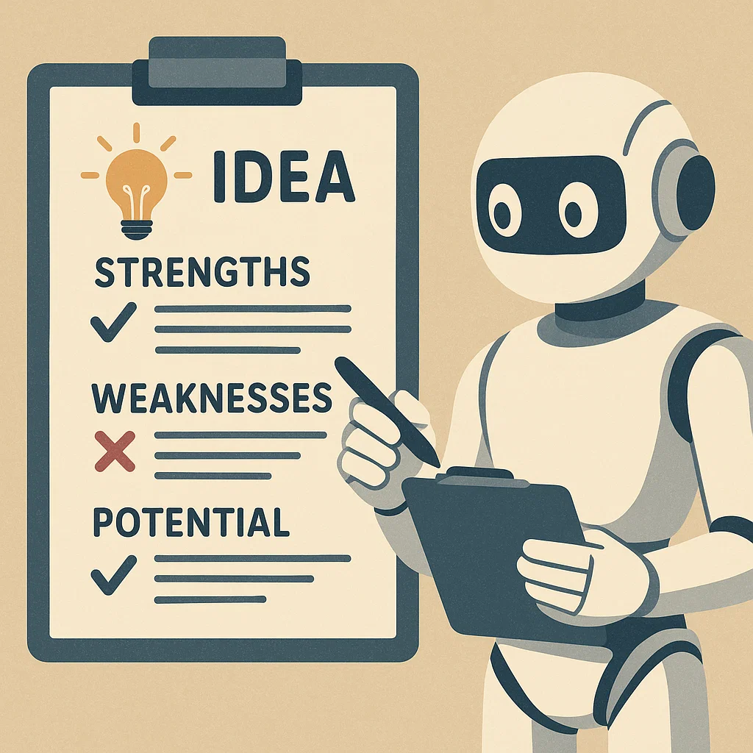
Template #..

Slide 6
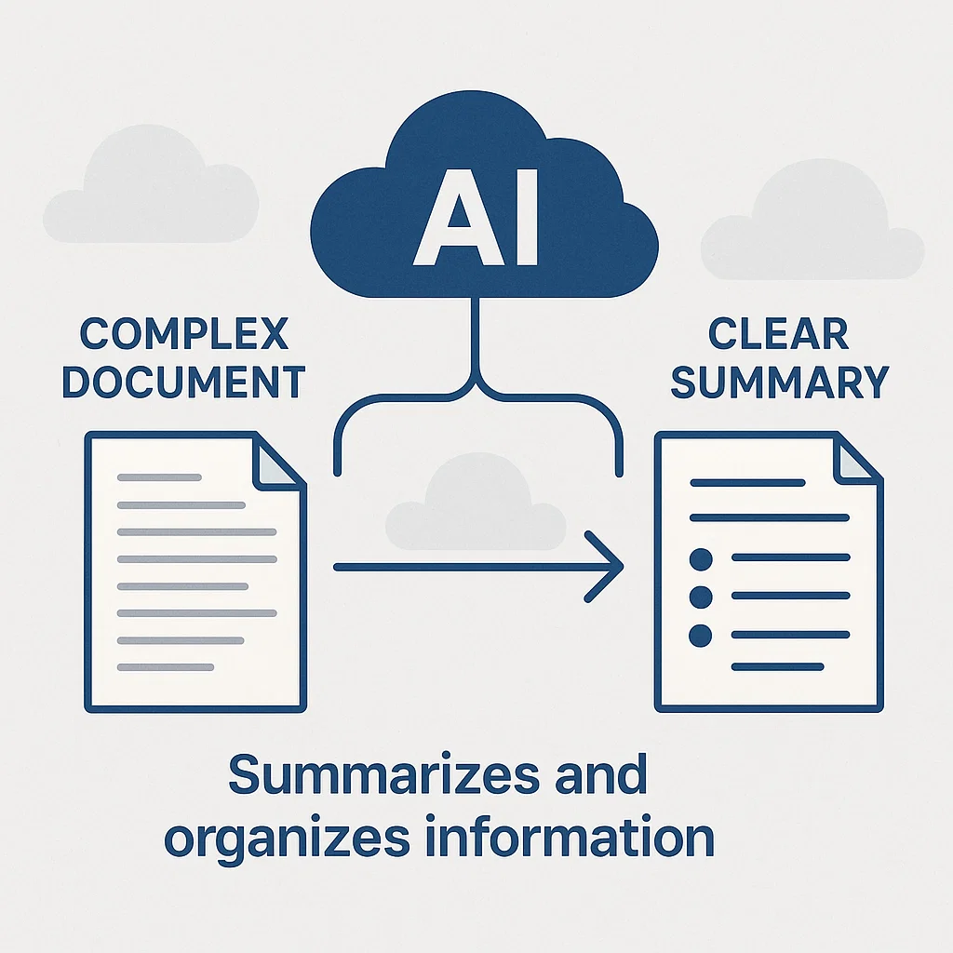
Template #..

Slide 7

Template #..

Slide 8
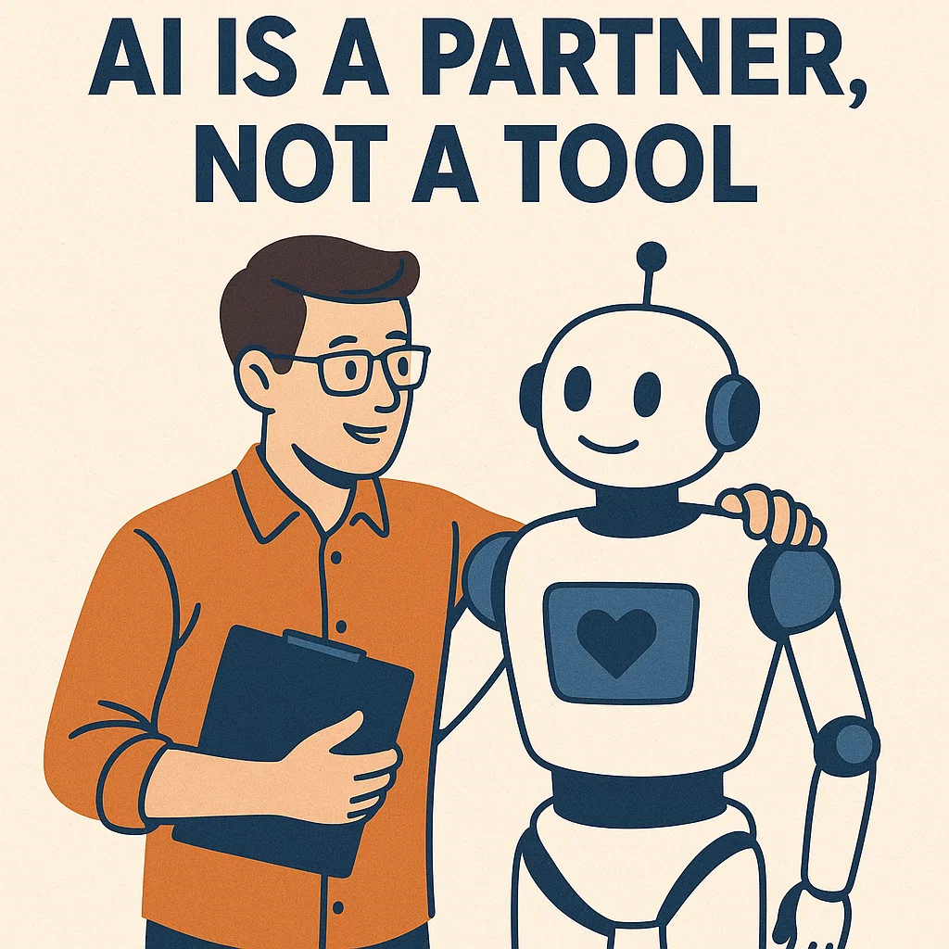
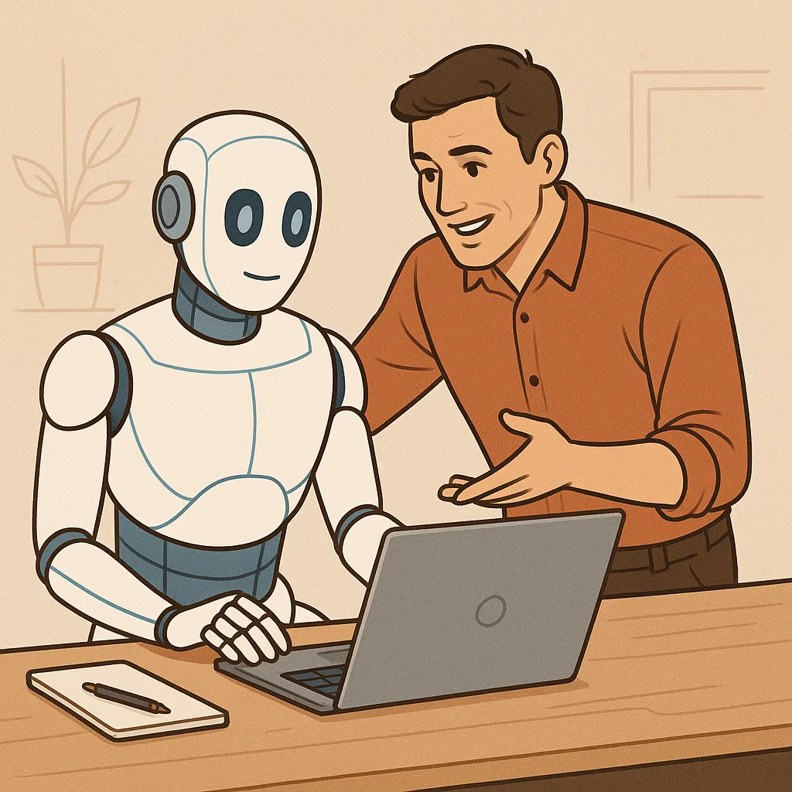
Template #..

Slide 9

Template #..

Slide 10
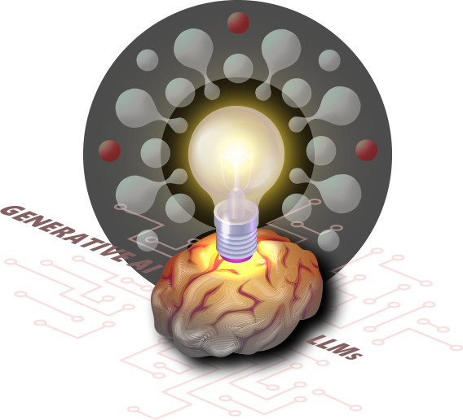
Template #..

Slide 11
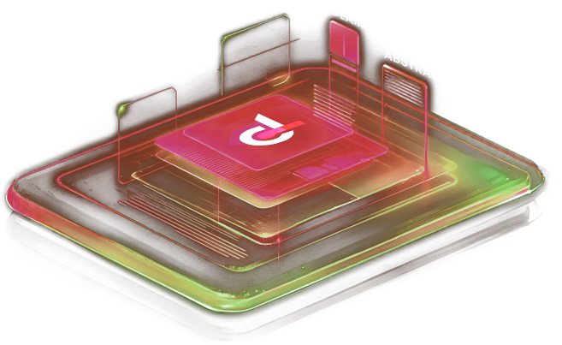
Template #..

Slide 12
Template #..

Slide 13
Template #..

Slide 14
Template #..

Slide 15
Template #..

Slide 16
Template #..

Slide 17
Template #..

Slide 18
Template #..

Slide 19
Template #..

Slide 20

Template #..
You are a professional innovator in the field of Facial Recognition.
The problem we are facing is: There are twins in the system that the system cannot distinguish between.
Brainstorm 10 different solution ideas for this problem, without any technology limitation. Each idea should include:
A short solution name.
A detailed description (about 2-3 sentences).
Core technology used.
Main advantages.
Potential challenges in implementation.

Slide 21
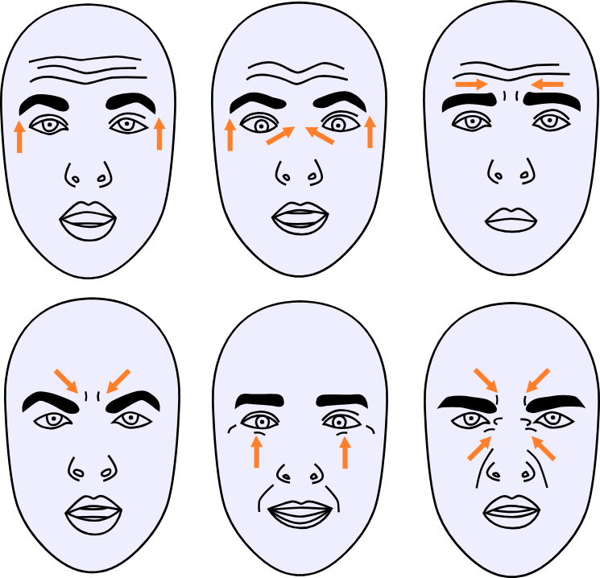
Result 1.
Micro-Expression Analysis
Description: Analyze subtle, involuntary micro-expressions that differ between twins due to unique emotional responses or personality traits. The system captures and compares fleeting facial movements during specific stimuli to create distinct profiles.
Core Technology: High-resolution video capture, AI-driven micro-expression analysis, and machine learning for pattern differentiation.
Main Advantages: Highly individualized as micro-expressions are unique even in twins; non-invasive and can be integrated into existing facial recognition systems.
Potential Challenges: Requires high-quality cameras and real-time processing; distinguishing micro-expressions consistently may be affected by environmental factors or emotional states.

Slide 22
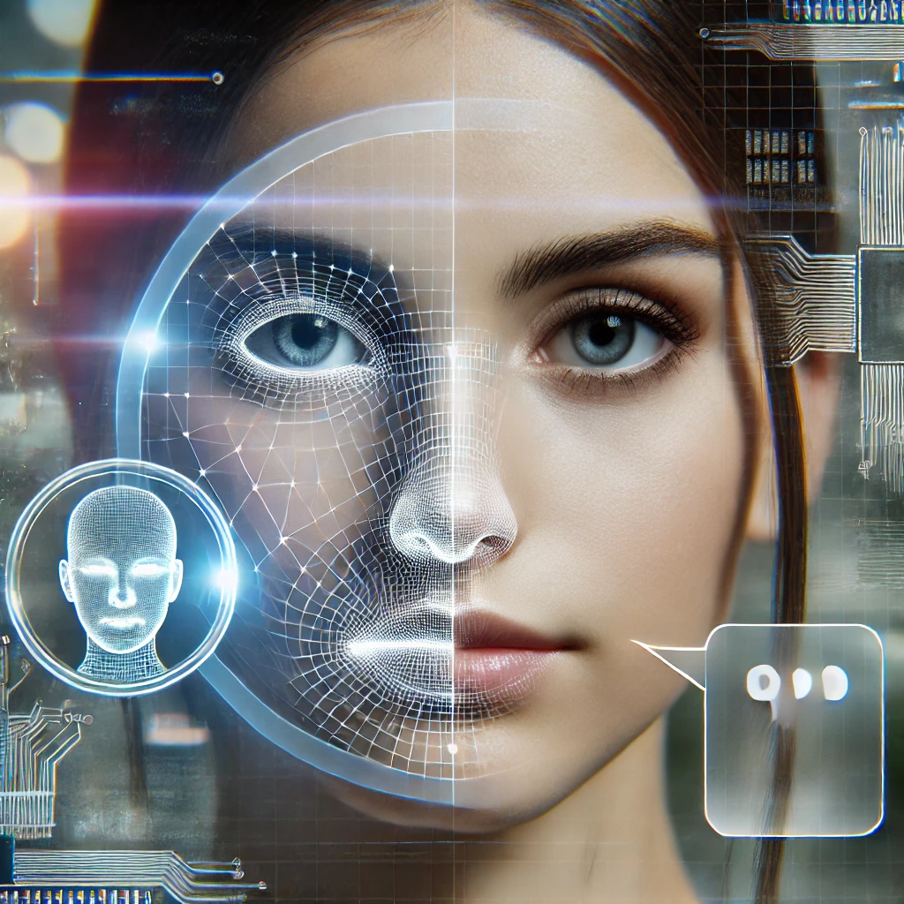
Result 2.
Voice-Integrated Multimodal Recognition
Description: Combine facial recognition with voice analysis, as twins often have subtle vocal differences in pitch, tone, or cadence. The system cross-references facial and vocal data for identification.
Core Technology: Speech recognition AI, multimodal biometric fusion algorithms.
Main Advantages: Enhances accuracy by using multiple biometric markers; voice data is relatively easy to collect.
Potential Challenges: Voice can be affected by illness or environment; requires users to speak during identification, which may not always be feasible.

Slide 23
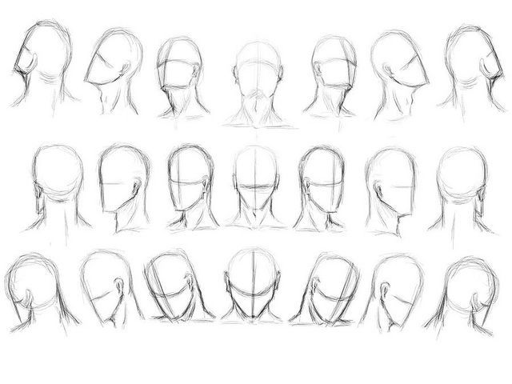
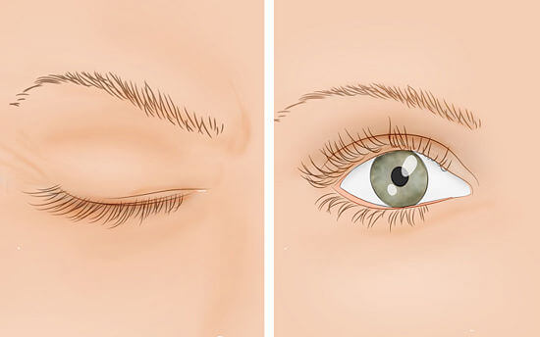
Result 3.
Gait and Behavioral Biometrics
Description: Incorporate gait analysis and behavioral patterns (e.g., head tilt, blink rate) to differentiate twins. These subtle differences in movement or habits are captured via video and analyzed alongside facial data.
Core Technology: Computer vision, machine learning for behavioral pattern recognition.
Main Advantages: Non-intrusive and can work at a distance; behavioral traits are highly individualized.
Potential Challenges: Requires extensive training data for accurate modeling; may be less effective in constrained environments where movement is limited.

Slide 24
Template #..
You are a creative thinker who can find analogies from other fields.
Our problem is: Facial recognition systems have difficulty in cases of twins.
Find 3-5 examples of systems/phenomena in nature or other fields (biology, physics, society...) that have solved a similar problem.
For each example, explain:
The similarity between our problem and that example.
How that system/phenomenon solves the problem.
How we can apply that principle/mechanism to our Face Recognition solution.

Slide 25
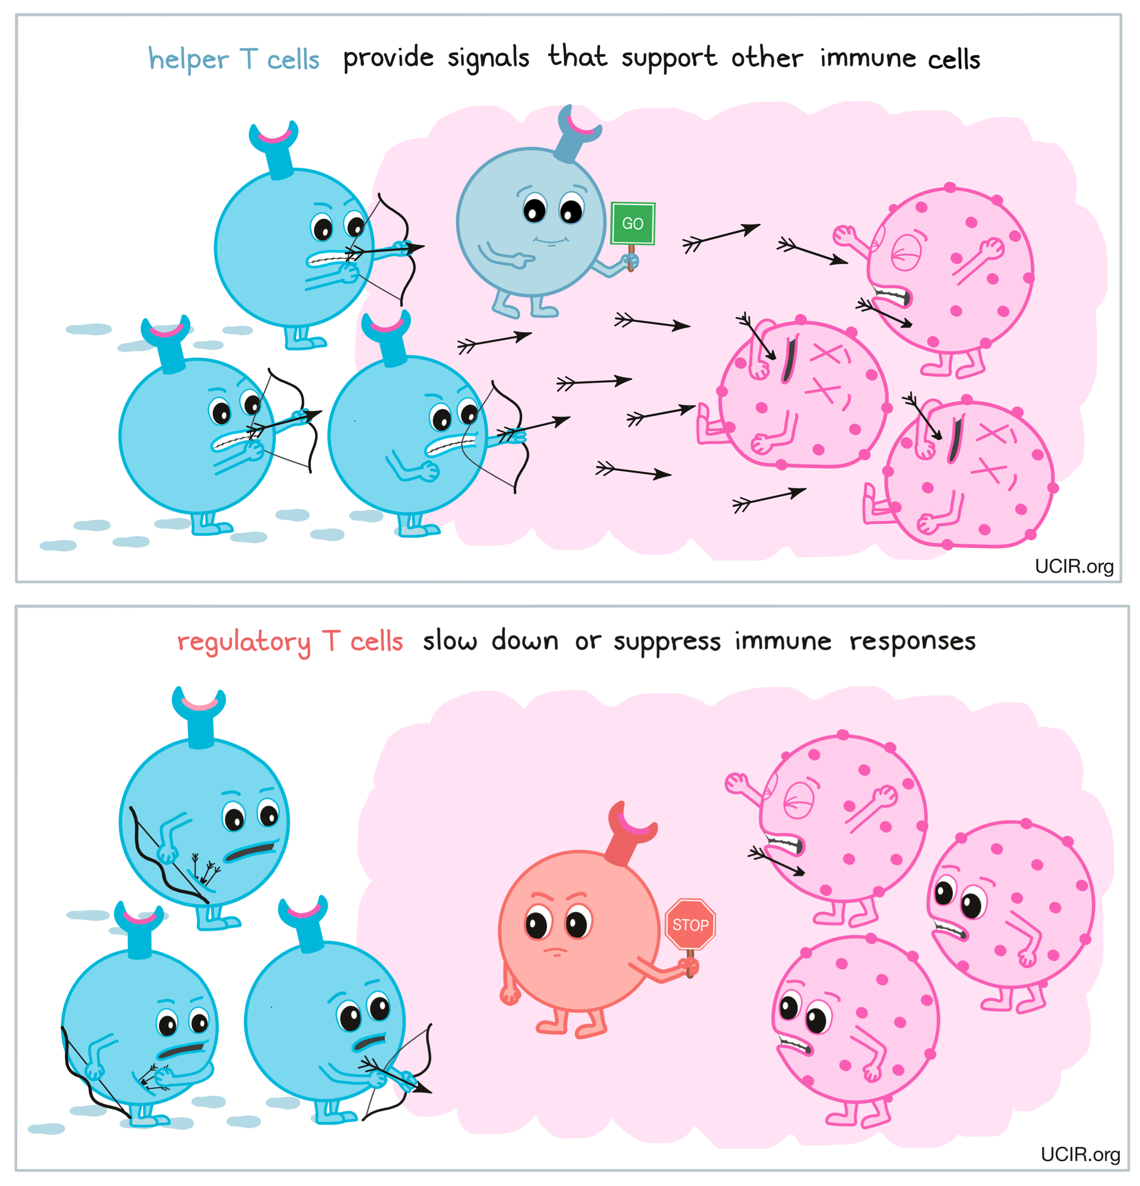
Result 1.
Immune System: T-Cell Recognition of Similar Antigens
Similarity: The immune system must distinguish between highly similar molecular structures, such as self-antigens (the body’s own cells) and foreign antigens (e.g., pathogens) or even between closely related pathogens.
How It Solves the Problem: The immune system employs a combinatorial approach, integrating signals from various receptor interactions and contextual cues (e.g., inflammation signals) to enhance specificity.
Application: Facial recognition systems could adopt a T-cell-inspired multi-feature fusion approach that could incorporate secondary signals such as micro expressions, skin texture, or subtle asymmetries unique to each twin. For example, a deep learning model could consider dynamic features (e.g., the way a person smiles) alongside static features, improving accuracy.
Notes:
Kháng nguyên, hay còn gọi là antigen, là bất kỳ chất nào mà hệ miễn dịch của cơ thể nhận diện là "lạ" và kích thích phản ứng miễn dịch, thường là sản xuất kháng thể.
Nói cách khác, kháng nguyên là những "dấu hiệu" trên bề mặt của các tác nhân gây bệnh (như vi khuẩn, virus, nấm, ký sinh trùng) hoặc các tế bào bất thường (như tế bào ung thư), mà hệ miễn dịch sử dụng để nhận biết và tấn công.
Tự kháng nguyên (self-antigens) là các phân tử protein hoặc các chất có trên bề mặt tế bào của cơ thể, mà hệ thống miễn dịch của cơ thể có thể nhận biết và thường không tấn công.
Receptor, hay còn gọi là thụ thể, là một thành phần đại phân tử (thường là protein) nằm trên bề mặt tế bào hoặc bên trong tế bào. Chúng có vai trò quan trọng trong việc tiếp nhận và truyền tín hiệu, giúp tế bào phản ứng với các kích thích từ môi trường bên ngoài hoặc từ các tế bào khác.

Slide 26
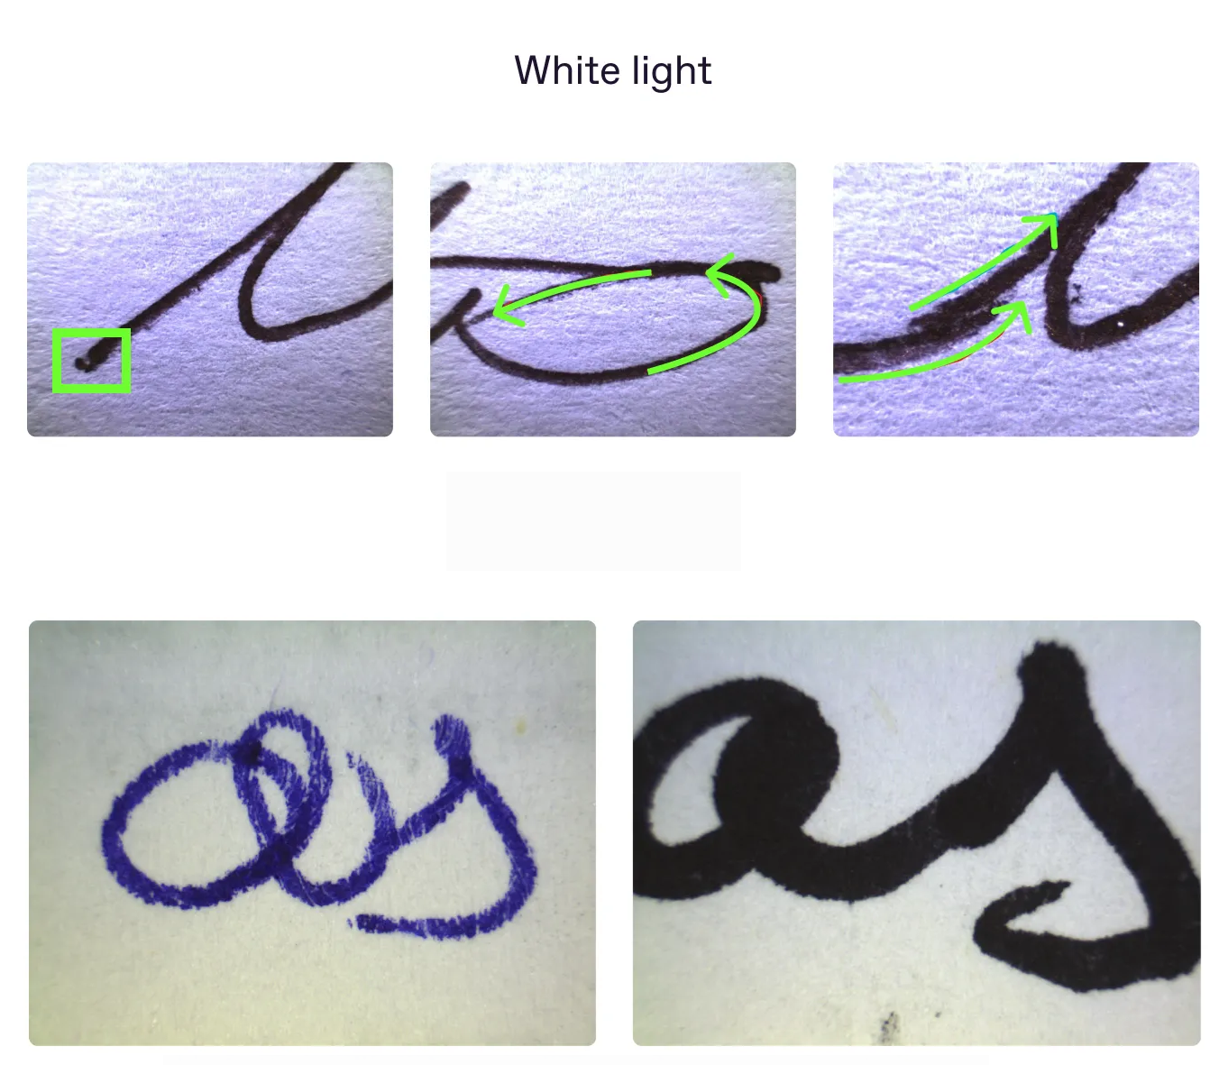
Result 2.
Forensic Handwriting Analysis
Similarity: Forensic handwriting analysis must differentiate between highly similar handwriting samples, such as those from twins or individuals trained to mimic each other’s writing.
How It Solves the Problem: Forensic experts analyze subtle, individual-specific traits in handwriting, such as stroke pressure, letter slant, or unique flourishes, which persist even in highly similar samples.
Application: Facial recognition could adopt a forensic-inspired approach by focusing on micro-level facial details and patterns. Algorithms could analyze fine-grained features like freckle placement, scar patterns, or subtle muscle movements (e.g., during speech).

Slide 27
Question !
“Are the above ideas ready to be implemented and developed?”

